Slide 1
Visual Studio Walkthrough

Slide 2
Using Visual Studio
Create Project
Add Source Files
Type Code
Compile/Debug
Run/Debug
Save Output (optional)
Save Project
Reopen Project

Slide 3
Step 0: Open the Program
On the Lab Computers: Start →All Programs→ECS Software→ ECS Computer Science Software→ Compilers_IDEs→ Microsoft Visual Studio 2010

Slide 4
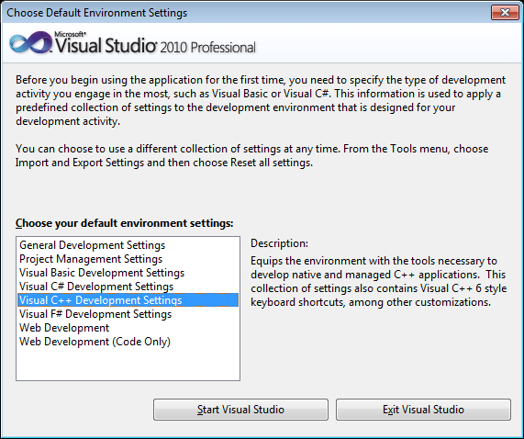
Step 0: First Time Only
Select Visual C++

Slide 5
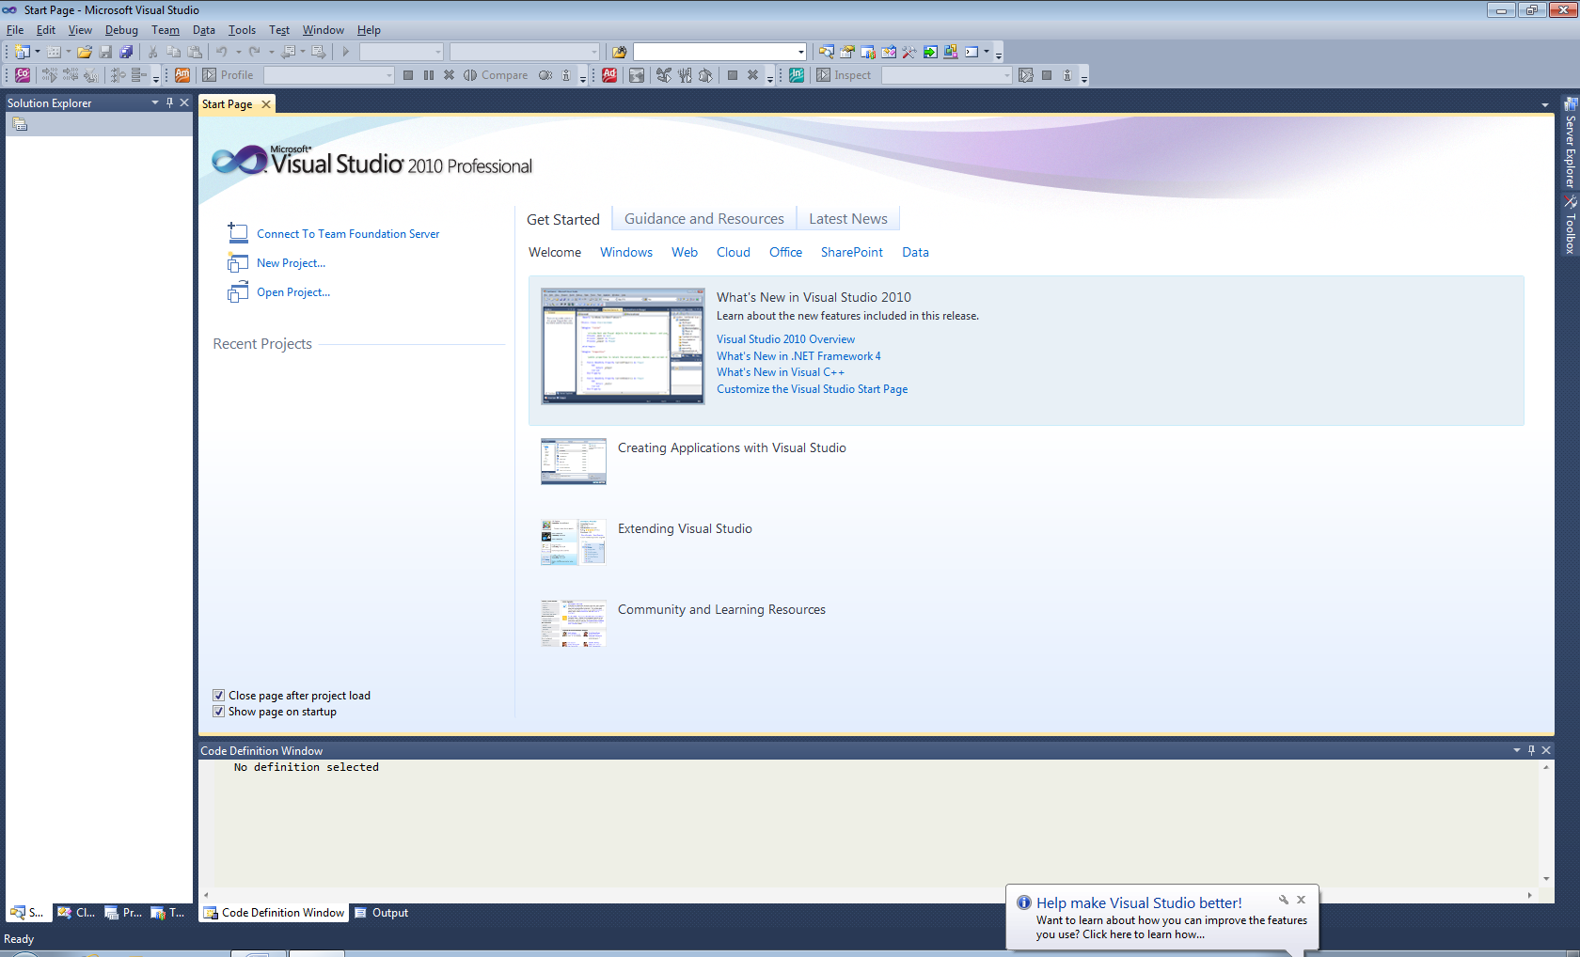
Step 0: Starting Visual Studio
Start Page: Informational: Can be closed.
Work Area: Edit source code.
Solution Explorer: View project files
Output: Results of compiling or running.

Slide 6
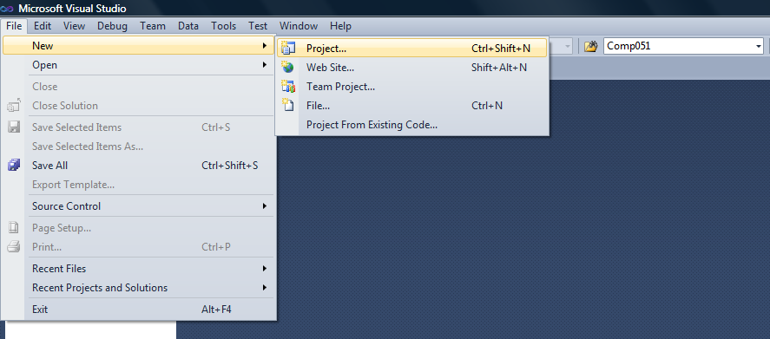
Step 1: Create Project
File → New → Project…

Slide 7
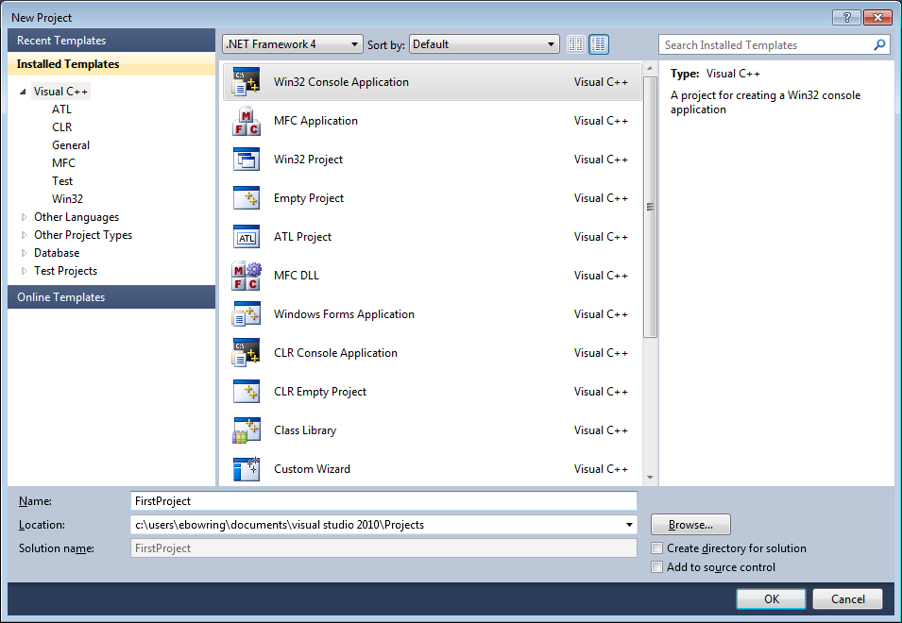
Step 1: Create Project
For text based applications, create a Win32 Console Application

Slide 8
Step 1: Create Project
Give project meaningful name
Project folder location: defaults to My Docs\VS 2010\Projects
Uncheck
Will create project folder called C:\comp51\first_project

Slide 9
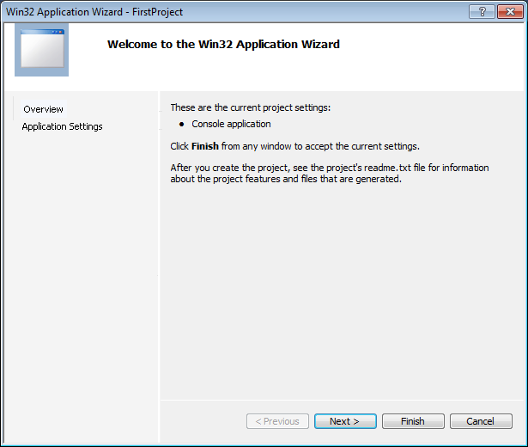
Step 1: Create Project
Use Wizard to configure project.
Click Next >

Slide 10
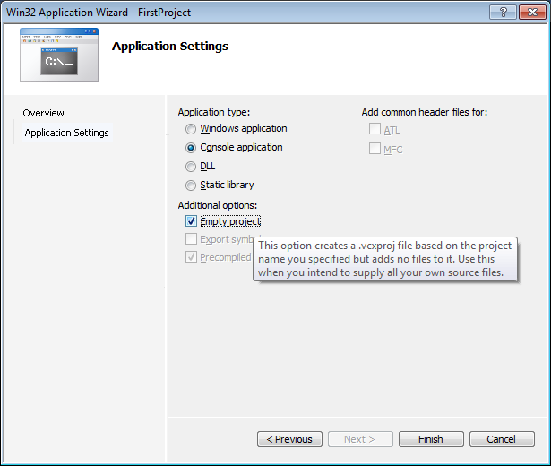
Step 1: Create Project
Select Empty Project

Slide 11
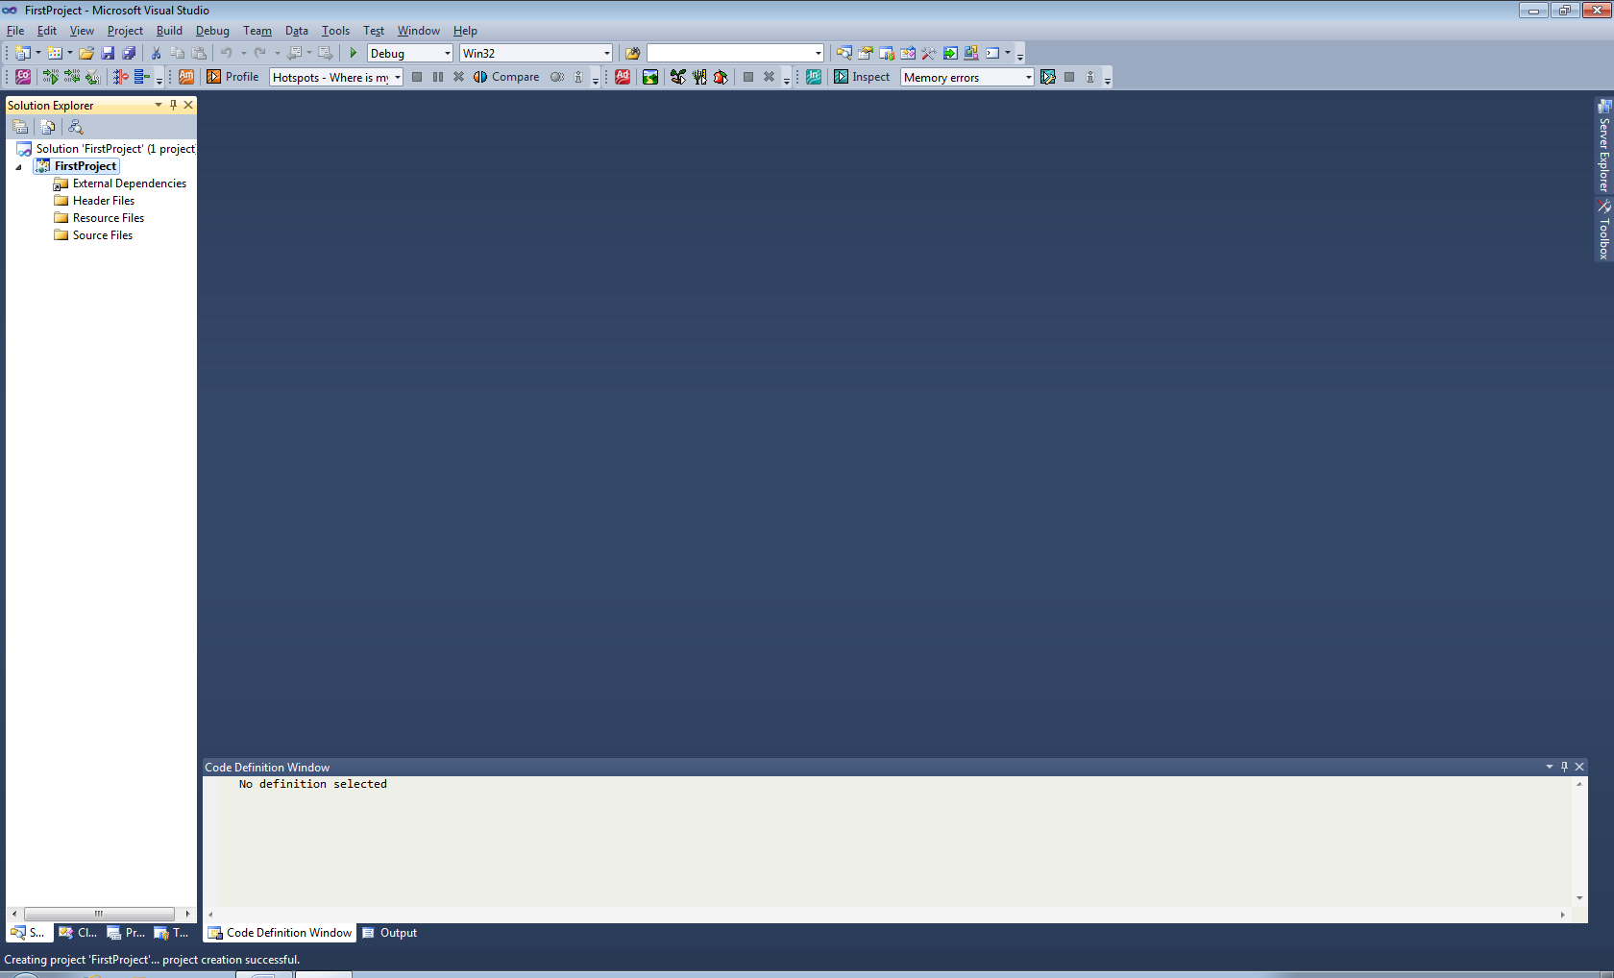
Step 1: Create Project
Project files will be listed here (once created)

Slide 12
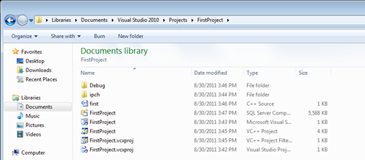
Step 1: Create Project
Created folder containing empty C++ project.
location: C:\My Documents\Visual Studio 2010\Projects project name: first_project

Slide 13
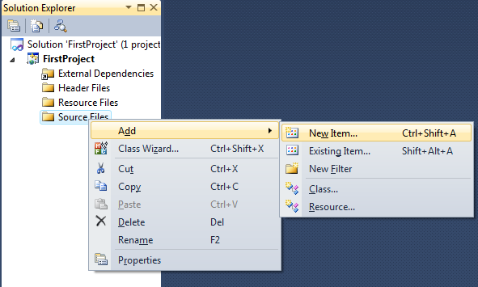
Step 2: Create Source Code File
Source code files contain your program code.
Right-click on Source Files and Add → New Item

Slide 14
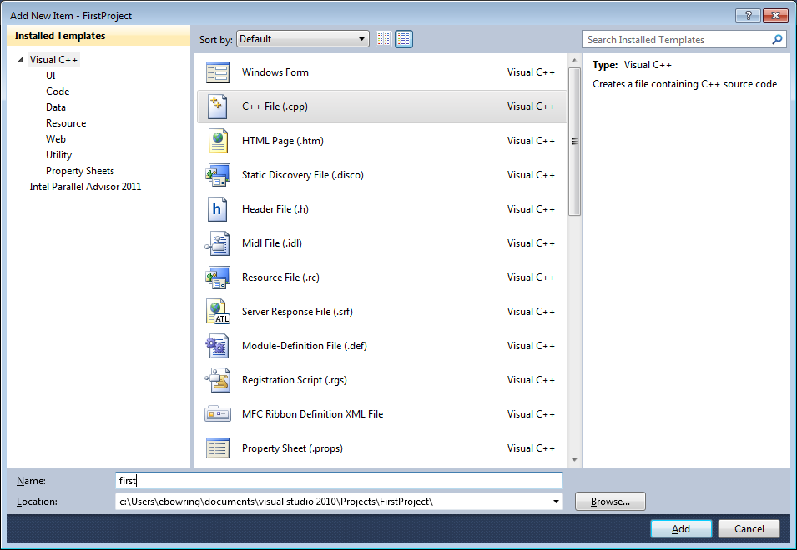
Step 2: Create Source Code File
Select C++ File
Name file e.g. first.cpp
Don’t change. We want to keep files in project folder.

Slide 15
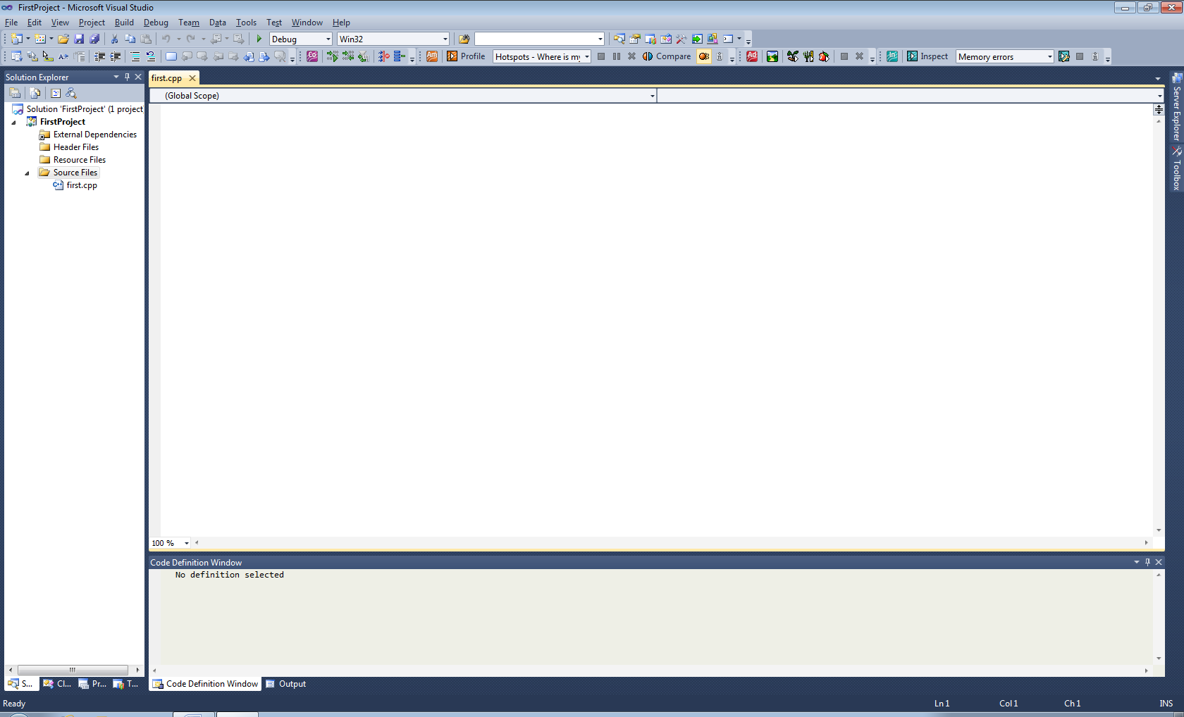
Step 2: Create Source Code File
New file appears in project listing
New file is open to write code in.

Slide 16
Step 2: Create Source Code File
New file also appears in project folder

Slide 17
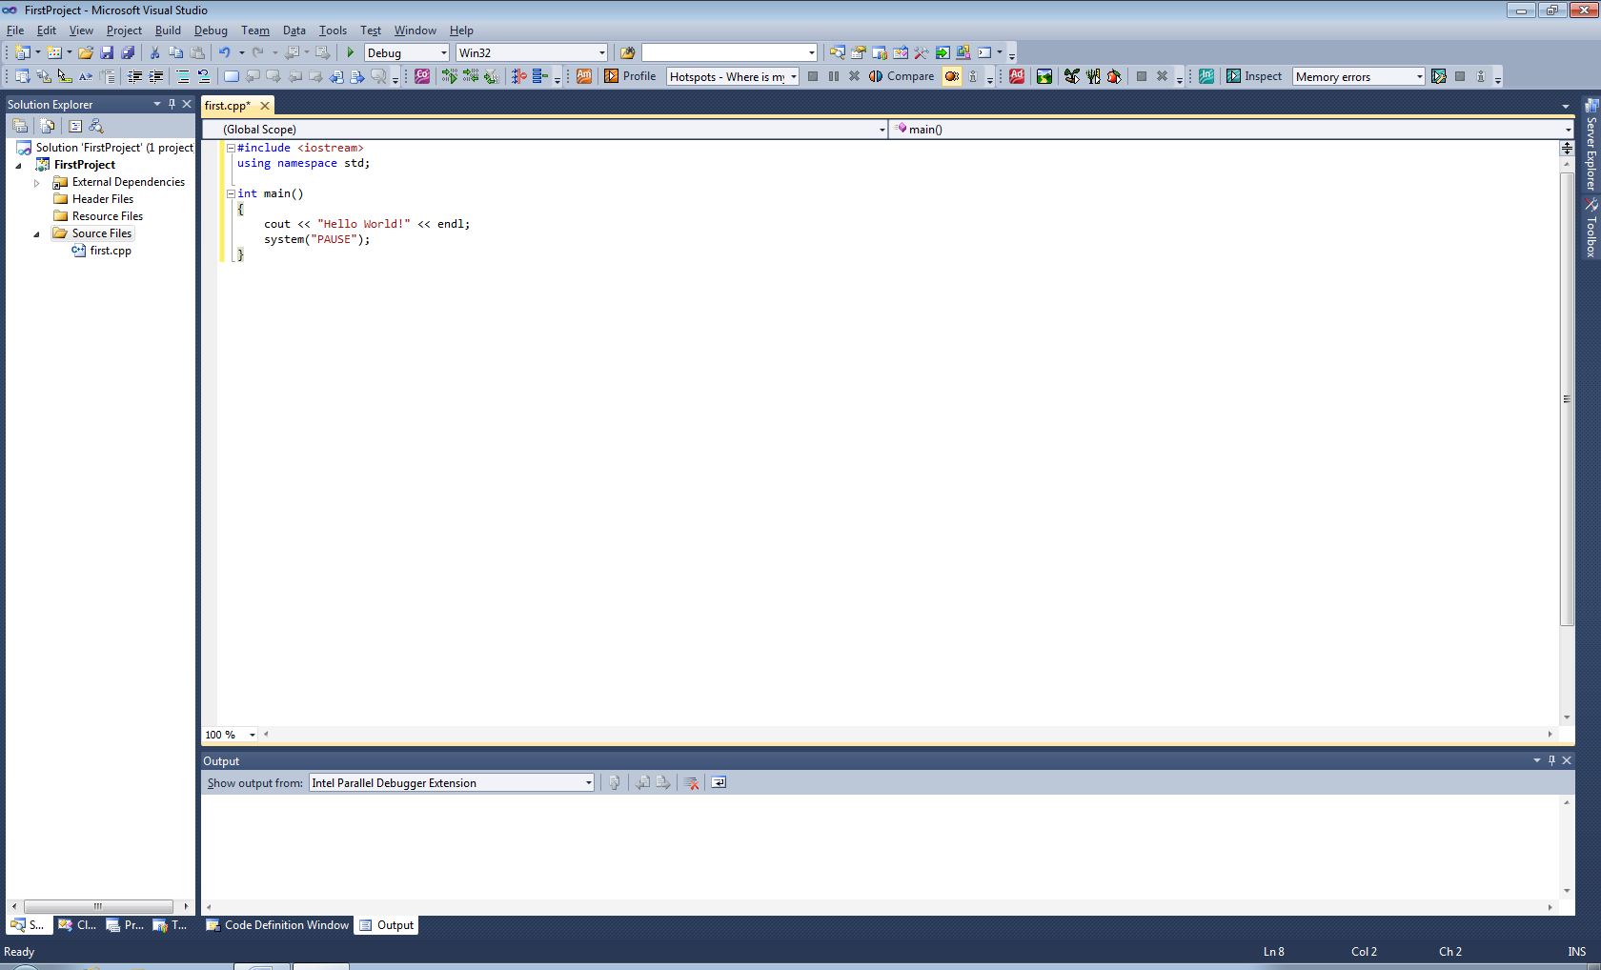
Step 3: Type Code

Slide 18
Step 3: Hello World Code
#include <iostream>
using namespace std;
int main()
{
cout << "Hello World!" << endl;
system("PAUSE");
}

Slide 19
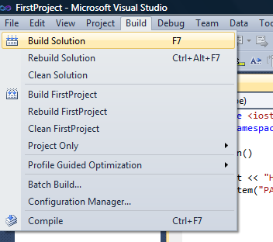
Step 4: Compile Code
Attempts to translate your code to machine code

Slide 20
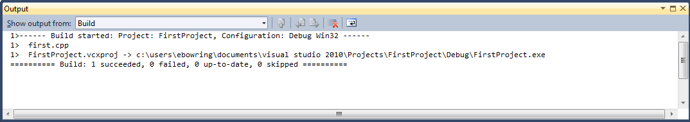
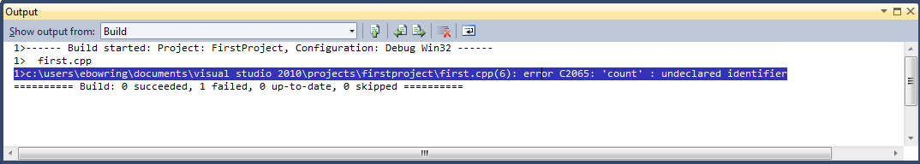
Step 4: Compile Code
Attempts to translate your code to machine code
Output Window: Syntax Errors
double-clicking on error message will take you to error

Slide 21
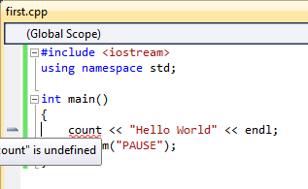
Step 4: Compile Code
Syntax errors: underlined in red.
Hovering reveals more detail

Slide 22
Step 4: Compile Your Code
Will create Debug folder in project.
Contains the machine code
Large folder. Can be deleted before moving/submitting your project.
Folder containing machine code

Slide 23
Step 5: Test/Debug Program
To run: Debug → Start Debugging or
What does your program do?

Slide 24
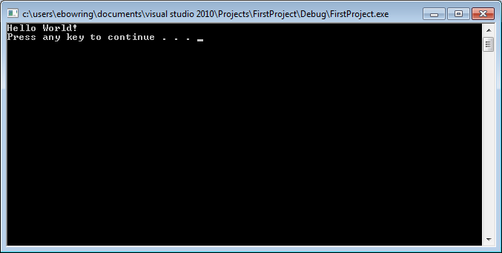
Step 5: Test/Debug Program
To run: Debug → Start Debugging or

Slide 25
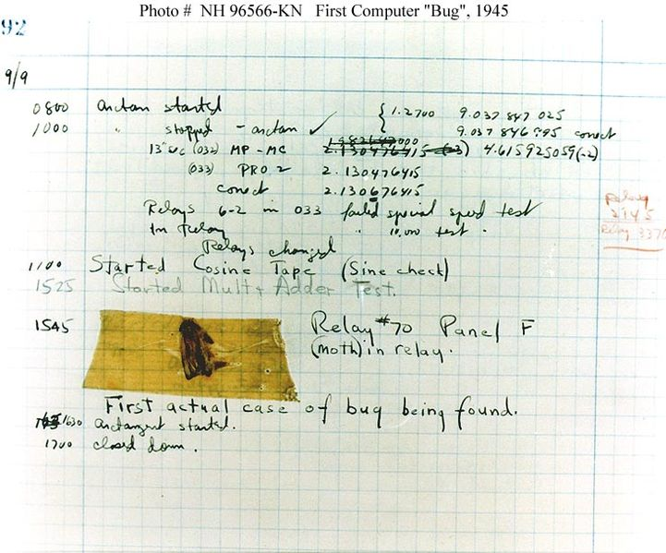
Debugging
If doesn't work, have to debug program code Repeat steps 3-5, until correct
3: Edit source code
4: Compile
5: Run

Slide 26
Step 6: Record Output (optional)
To save output
Right-click border
Edit → Select All
Hit Enter to copy the highlighted text
Open file to paste into: Ctrl-V

Slide 27
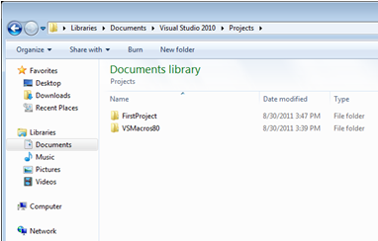
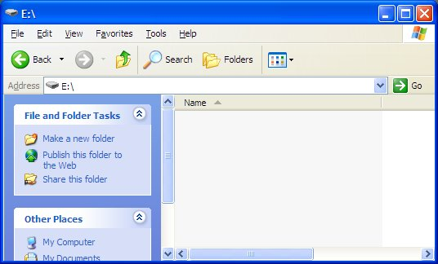
Step 7: Save Project
Navigate to project location
Delete Debug sub-folder
Location of project
Removable drive or network drive

Slide 28
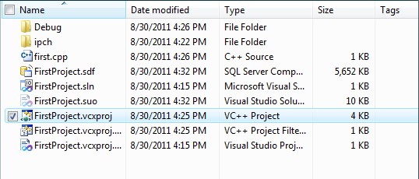
Step 8: Reopen a Project
Double-click on the project file (*.vcproj)
will launch Visual Studio and load project
Can also load project: File→Open→Project/Solution

